Slide 1


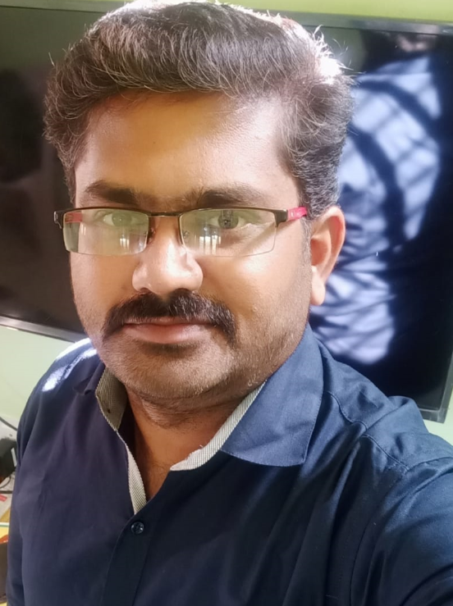

REST
TEAM CRAWLERS
SEARCH ENGINE
FNO
PaaS
JayaChandra
Jyoti Yadav
HELM
DB
Mani Rathinam
Mantu Kumar Sharma

Slide 2
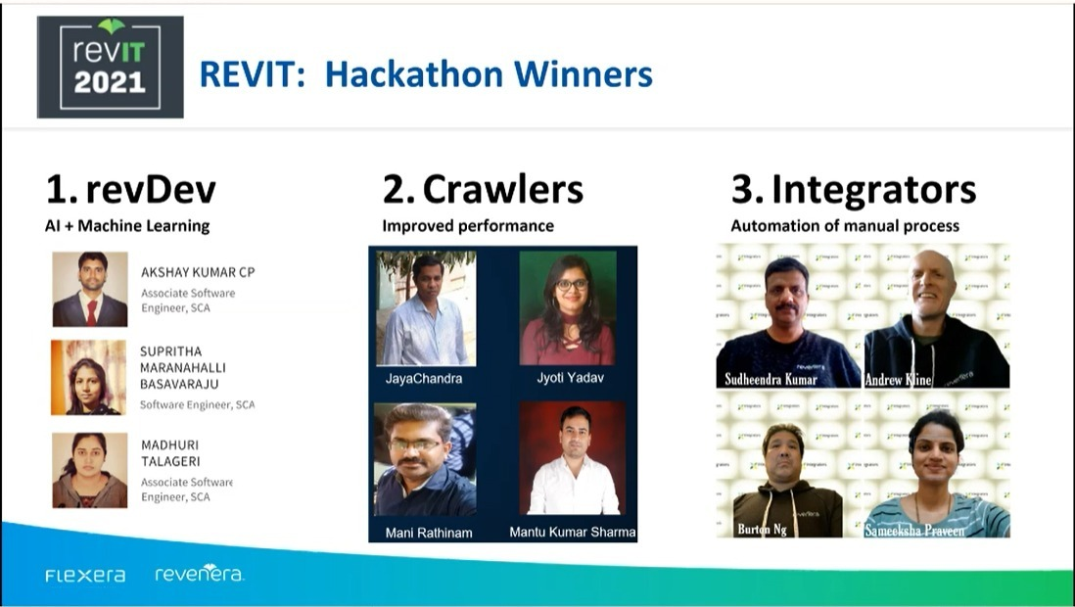
REST
FNO
PaaS
HELM
DB

Slide 3
PROBLEM STATEMENT
REVENERA
Slowness in fetching results from the FNO UI, decreased performance, buffering and increased latency.
Application stability & Performances challenges.
Retaining customer is challenging because of the application performance & in recent past a few customers have left (McAfee, Carl Zeiss).
Slowness in complex querying results from the reporter.
Introducing new features and taking Design decisions are challenging for e.g., splitting custom attribute, adding tenant IDs to the table etc. as it ultimately degrades the existing application performance.
FNO DB is maintaining 1TB of data currently in PROD which is a huge number. FNO MAIN Size = 922,265 MB (1TB),
LFS Size = 6,935,037 MB (6TB)
Customers are unhappy due to latency in our webservices and UI response.

Slide 4
—BILL GATES
“Your most unhappy customers are your greatest source of learning”

Slide 5

SOLUTION
Utilize Search Platform with NoSQL DB ,Platform as a Service to handle huge volume of data.
Providing RESTful API-driven(HTTP + JSON), so actions can be performed using a simple RESTful API Call.
Ensuring API Response is in millisecond which was earlier in minutes.
Data Compression & Faster Indexing.
Tenant & ORG level Document search Strategy for faster response with O(1) time complexity and proper column indexing.
Make sure Zero down time, auto scaling and 24/7 support service.
Ensure Shards & Replicas creation is faster and easy.
Light Weight and Multi-Tenancy Support.
OPTIMIZED PERFORMANCE
FAST AND RELIABLE

Slide 6

TECH STACK
Design Stack: Java, Spring Boot, Circuit Breaker (Hystrix).
Design-time Interaction: Service Provider (Search Platform PaaS), Service Consumer (chat window app & FNO UI) Service Registry(NGINX).
Run-time Interaction: K8S, Helm, Docker, Terraform & Ansible.
Micro Service Solution: API Proxy, AWS Cloud.
Messaging/MQ: Rabbit MQ (Existing), Kafka(preferable).
No SQL: Elastic Search (ELK stack).
Cloud Computing: AWS, Auto scaling EC2,Subnets ,ECS Cluster, VPC etc.
Problem Solving: Data Structure and Algorithms like Trie DS, Bloom filter, roaring bitmaps, indexing bitmaps etc.
Responsive UI : React JS

Slide 7
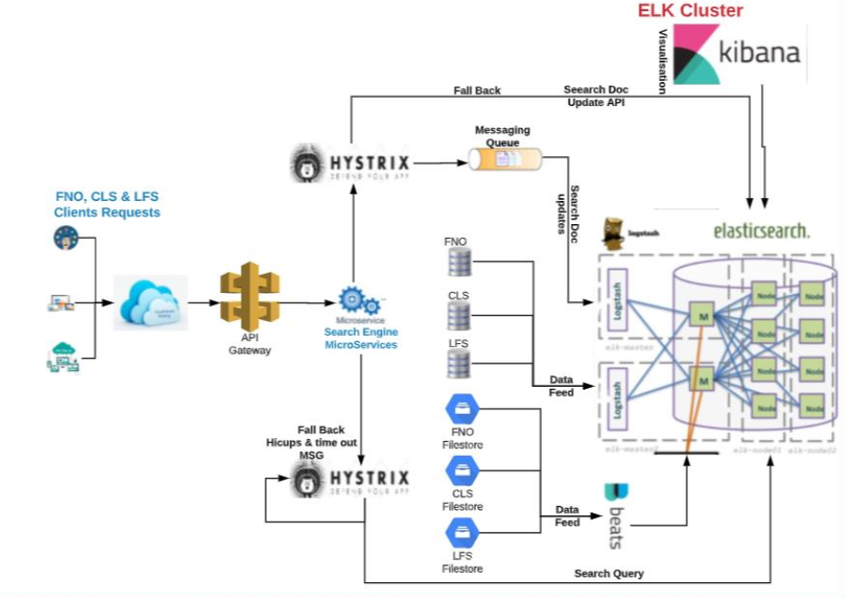
SEARCH PLATFORM ARCHITECTURE

Slide 8
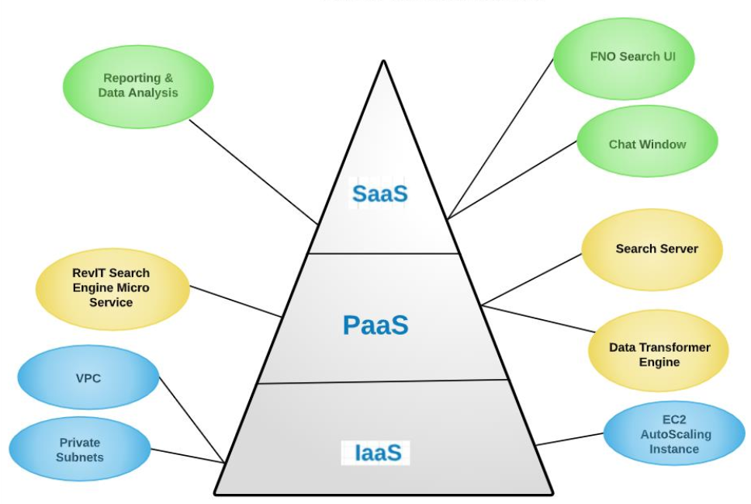
HIGH LEVEL ARCHITECTURE & SERVICE DETAILS

Slide 9
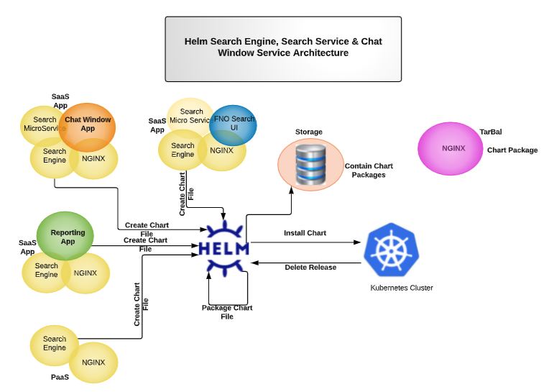
HELM ARCHITECTURE

Slide 10
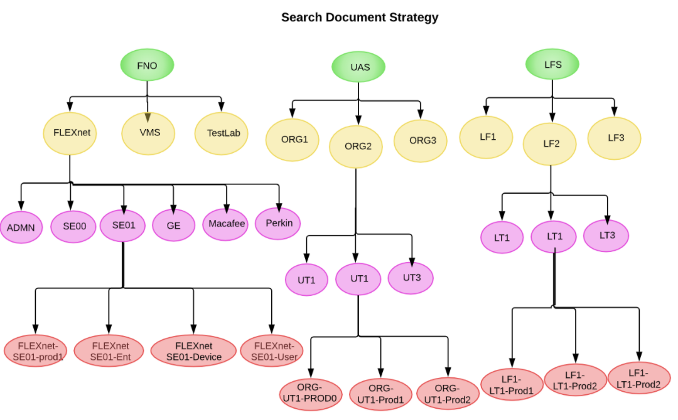
SEARCH DOCUMENT STRATERGY
Regional based indexing
Organizational hierarchy
ORG- Tenant-PROD
Personalized search
Favorites
Trending Contents on the TOP using Count Min Sketch Algorithms

Slide 11
Customer Onboarding Process & Data Transformations to Search Platform
Get the Data Source Details.
Get the DB script details.
Store tenant data source details in the AWS secret manager or d K8S secret component.
Create .conf file to Data transfer server.
Event process pipeline inputs → filters → outputs.
For real or near real time transformation schedule the jobs every second.
Start the job.
Data validation using search JSON API

Slide 12
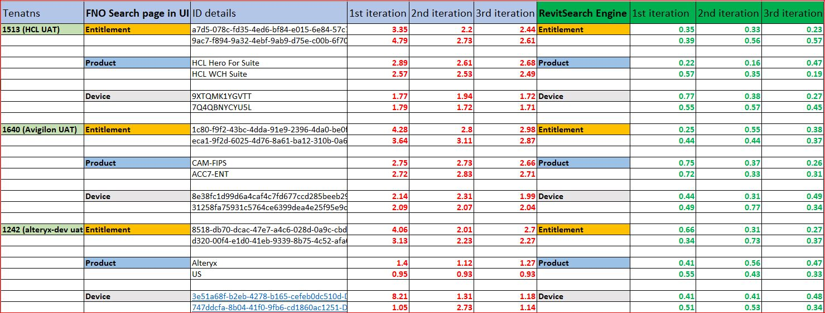


STATISTICS FNO Search UI Vs Search Platform UI

Slide 13
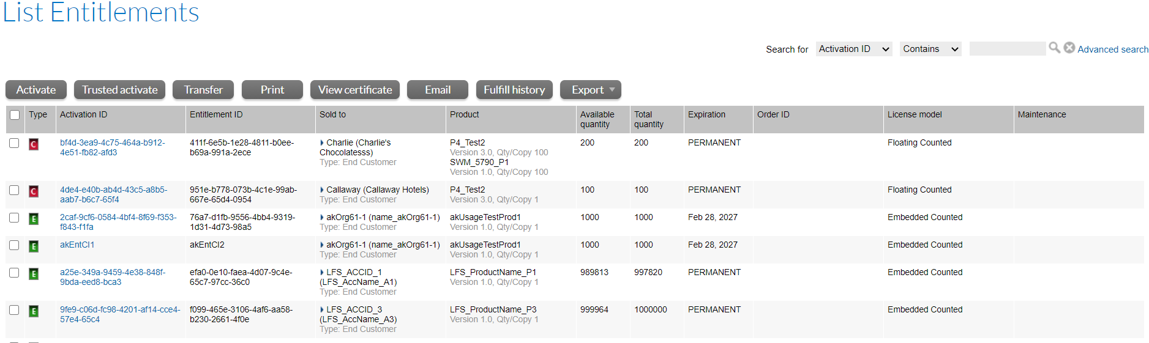
FNO Search UI Vs Search Platform UI
FNO UI
Continued on Next slide

Slide 14
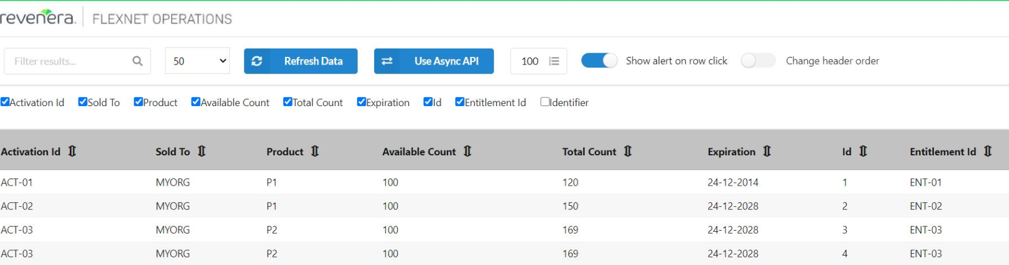
FNO Search UI Vs Search Platform UI
SEARCH PLATFORM UI

Slide 15
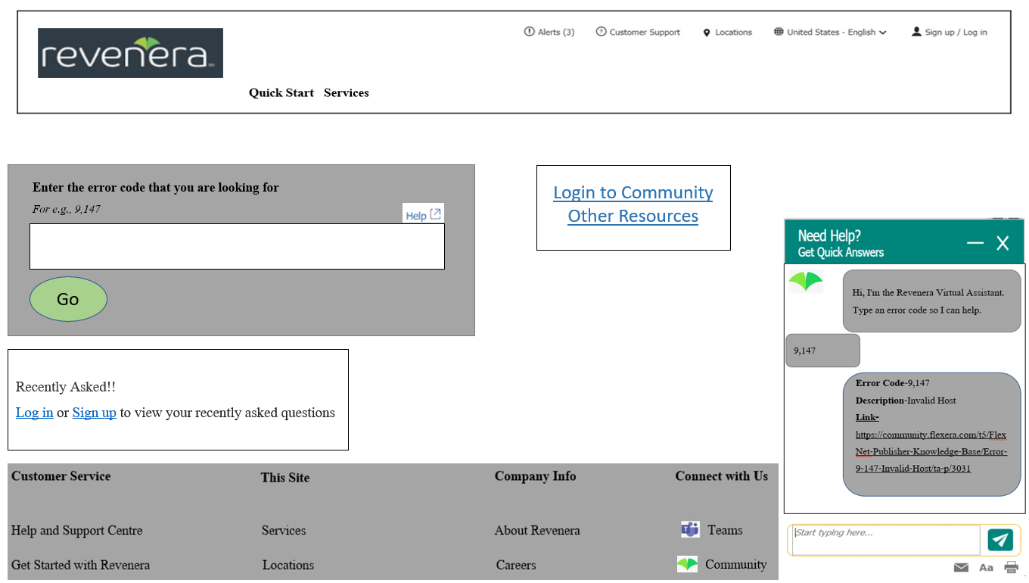
CHAT APPLICATION
Benefits of the Chat Application
Boost Efficiency
Increase Customer Satisfaction
Personalize your brand
Track Success
Gain a Competitive Advantage

Slide 16


ROADMAP
In future implementation we can start FNO upcoming implementation Monetization center - FNMS module task with Search Platform as this will handle huge data and response time would be in milliseconds
Aggregate data from our solutions and provide a dashboard with a single executive view for business-critical information
An optimized search solution can replace existing legacy data tools and slow down the data transformation process to provide faster access and make it available for analytical, statistical and give data insights.
Bring back CGM(Customer Growth Module) again to FNO leveraging from Search Platform.
Using the search platform API we can plan to create SaaS application(chat box) or a Virtual Assistant .

Slide 17
ADDITIONAL INFORMATION FOR REFERENCE

Slide 18
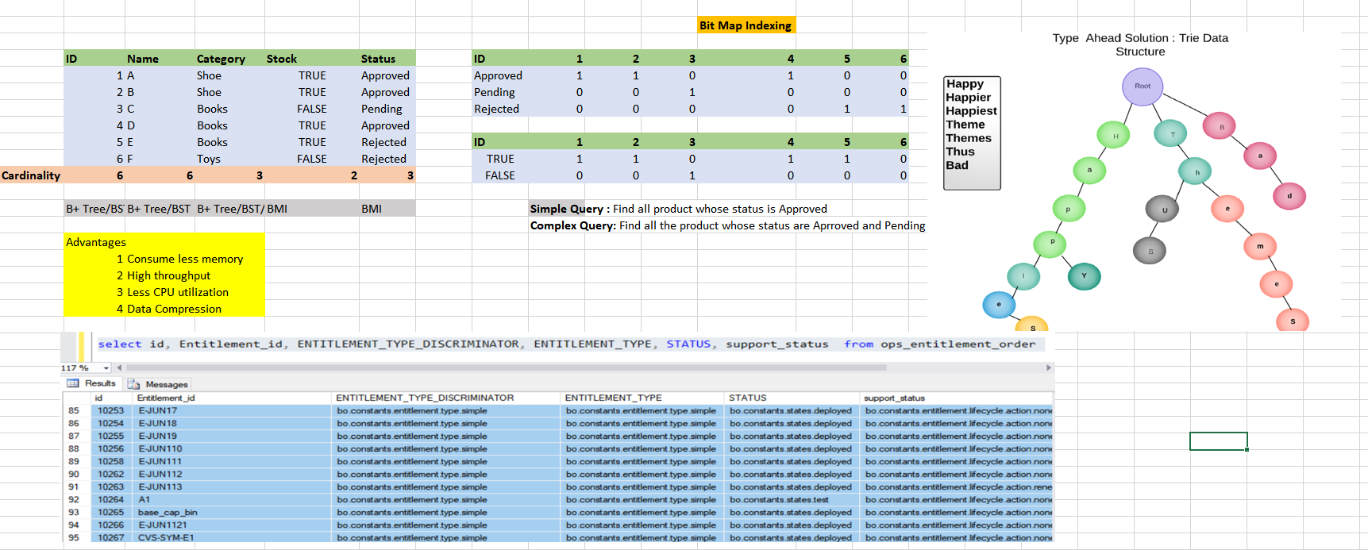
REQUIREMENTS/DETAILS

Slide 19
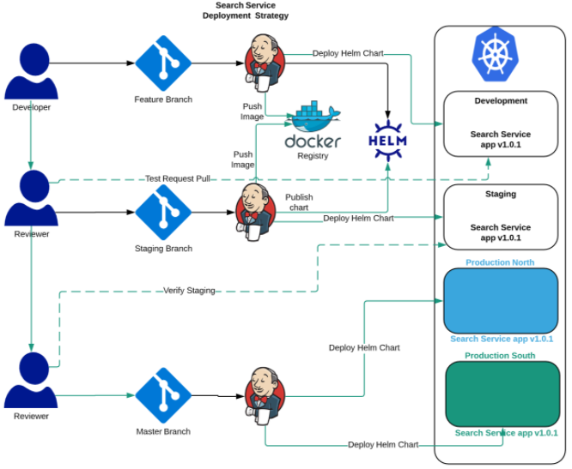
REQUIREMENTS/DETAILS

Slide 20
SEARCH API CONTRACT
Request URI – Type Ahead
http://localhost:8080/api/typeahead/{orgdetails}/{productname}
Method : GET
Response
[ "JC_CUST_PRODUCT_VALUE",
"JC_Product",
"JC_Productsdgsdfg",
"JC", "JC_product“
]
Request URI – Search Result
http://localhost:8080/api/searchresult/{orgdetails}/{productname
Method : GET
Response :
[ { "lastupdated": "2019-02-05T00:00:17.937Z", "@timestamp": "2019-03-20T09:29:53.042Z", "tenant_id": "1000", "belongstoset_id": 1095672, "textvalue": "JC_CUST_PRODUCT_VALUE", "id": 2071903 }, { "lastupdated": "2019-02-05T07:29:34.953Z", "@timestamp": "2019-03-20T09:29:53.042Z", "tenant_id": "1000", "belongstoset_id": 1095669, "textvalue": "JC_Product", "id": 2071932 }, ]

Slide 21
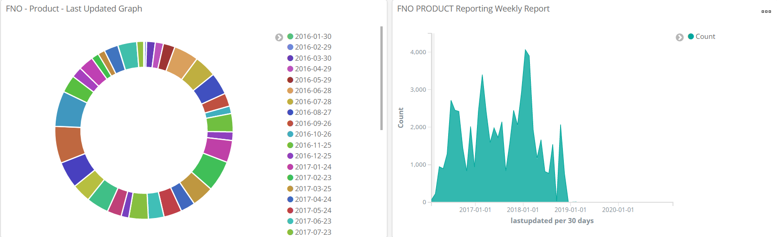
Reporting: Product Last Weekly Updated

Slide 22
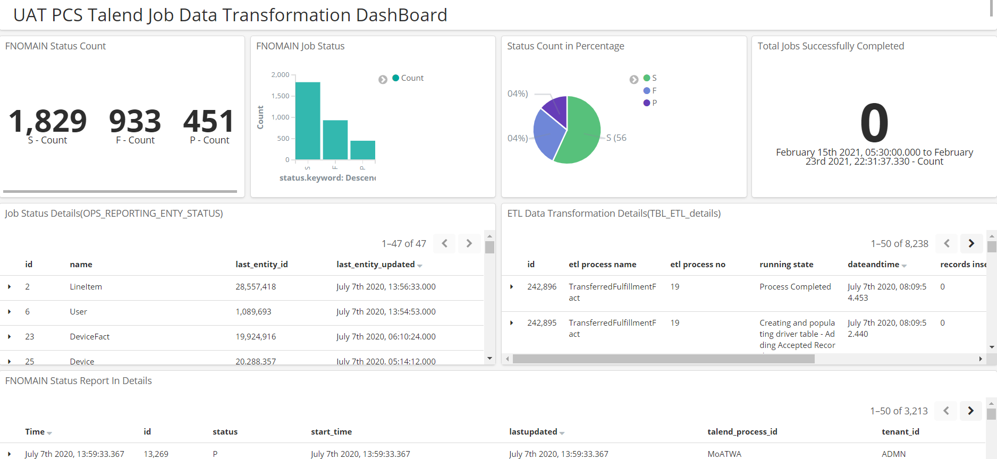

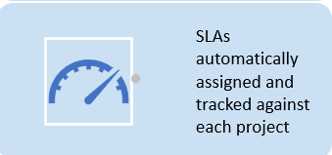

Slide 23
DEMO

Slide 24
JD

Slide 25
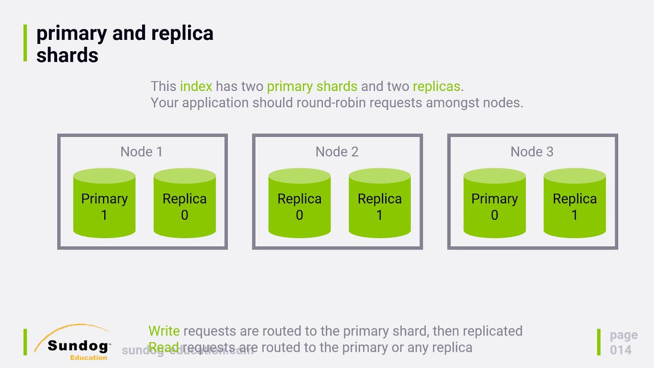
DEMO

Slide 26
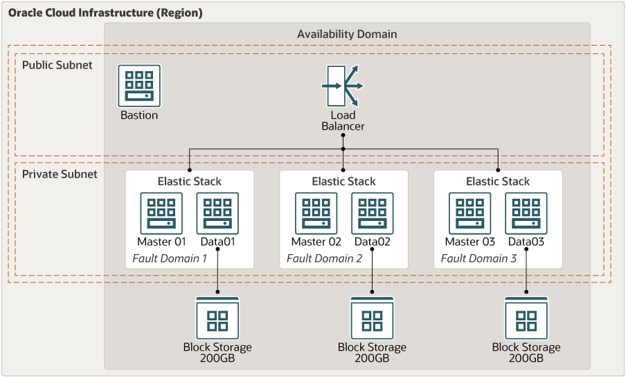
DEMO

Slide 27
SQL Config File
input {
 | jdbc {
 | jdbc_connection_string => "jdbc:sqlserver://.;databaseName=DBName;integratedSecurity=false;"
 | jdbc_user => "SQL_UserName"
 | jdbc_password => "SQL_Password"
 | jdbc_driver_library => "./logstash-core/lib/jars/mssql-jdbc-9.2.1.jre8.jar"
 | jdbc_driver_class => "com.microsoft.sqlserver.jdbc.SQLServerDriver"
 | statement => "SELECT TOP(1000) * FROM data.Table WITH(NOLOCK) WHERE Id > :sql_last_value ORDER BY Id ASC"
 | tracking_column => "id"
 | tracking_column_type => "numeric"
 | use_column_value => true
 | last_run_metadata_path => "./Log/.logstash_jdbc_last_run"
 | schedule => "*/30 * * * * *"
 | }
 | }
 | output {
 | elasticsearch {
 | hosts => ["http://localhost:9200"]
 | index => "indexName"
 | user => "elastic-username"
 | password => "elastic-password"
 | doc_as_upsert => true
 | document_id => "%{id}"
 | }
 | }

Slide 28

THANKS!
Open Forum for Questions and Answers.
addyouremail@freepik.com

